Slide 1
TASK 2: FINDING VULNERABILITIES OF A GIVEN WEBSITE STEPS TO BE FOLLOWED: STEP 1: OPEN VIRTUAL BOX AND LOGIN TO LINUX STEP 2: OPEN A VIRTUAL BANK WEBSITE , for example ., www.testfire.net STEP 3: OPEN NETSPARKER , IF IT IS NOT AVAILABLE YOU CAN DO THIS USING OWASP ZAP APP FOR VULNERABILITY FINDING STEP 4: OPEN OWASP ZAP THEN GIVE THE DETAILS OF THE WEBSITE EITHER THE URL OR IP ADDRESS STEP 5: THEN START ATTACKING STEP 6: U CAN SEE THE PROCESS , AFTER THE COMPLETION CLICK ON REPORT THEN SAVE IT AS .html FILE NOW THE REQUIRED REPORT IS SAVED STEP 7 : IN THE REPORT ,ALL THE REQUIRED WILL BE OBTAINED like., vulnerabilities ,url’s and the solution.

Slide 2
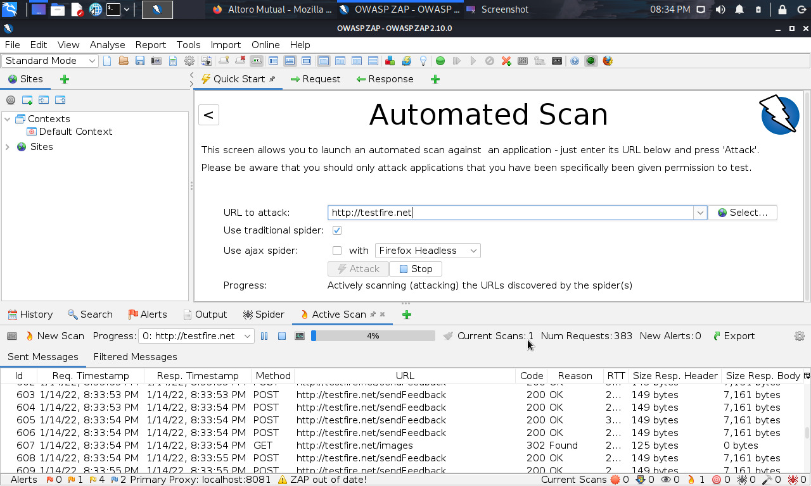

Slide 3
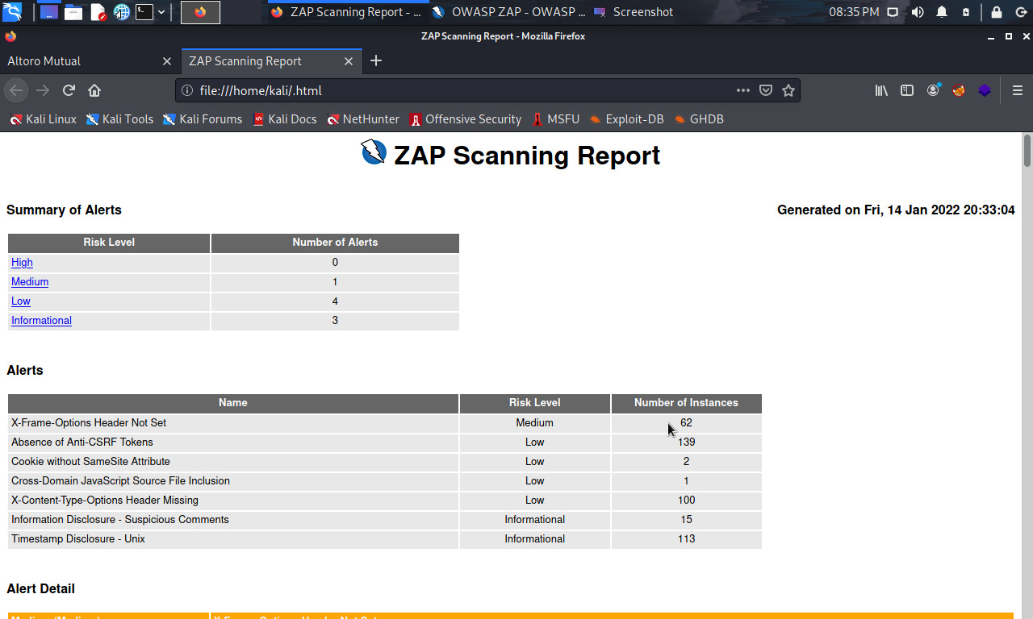

Slide 4
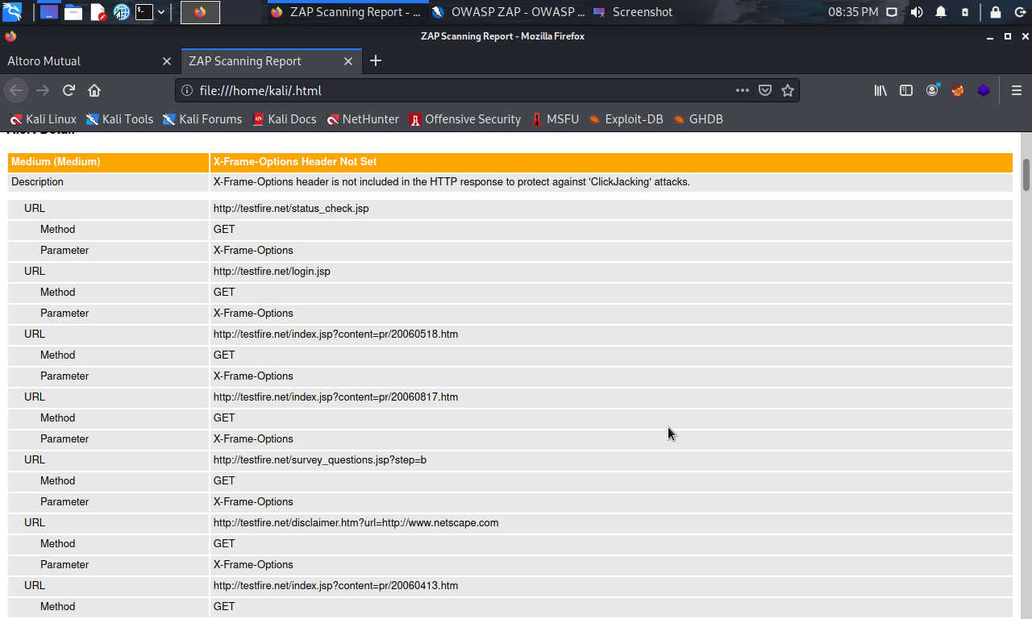
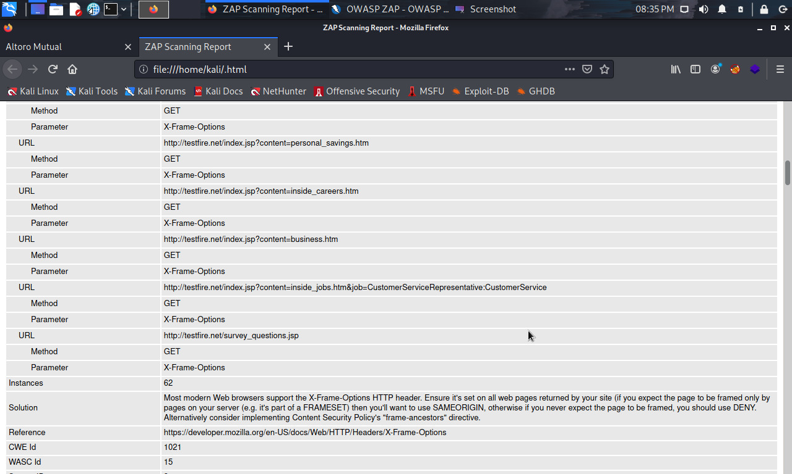

Slide 5
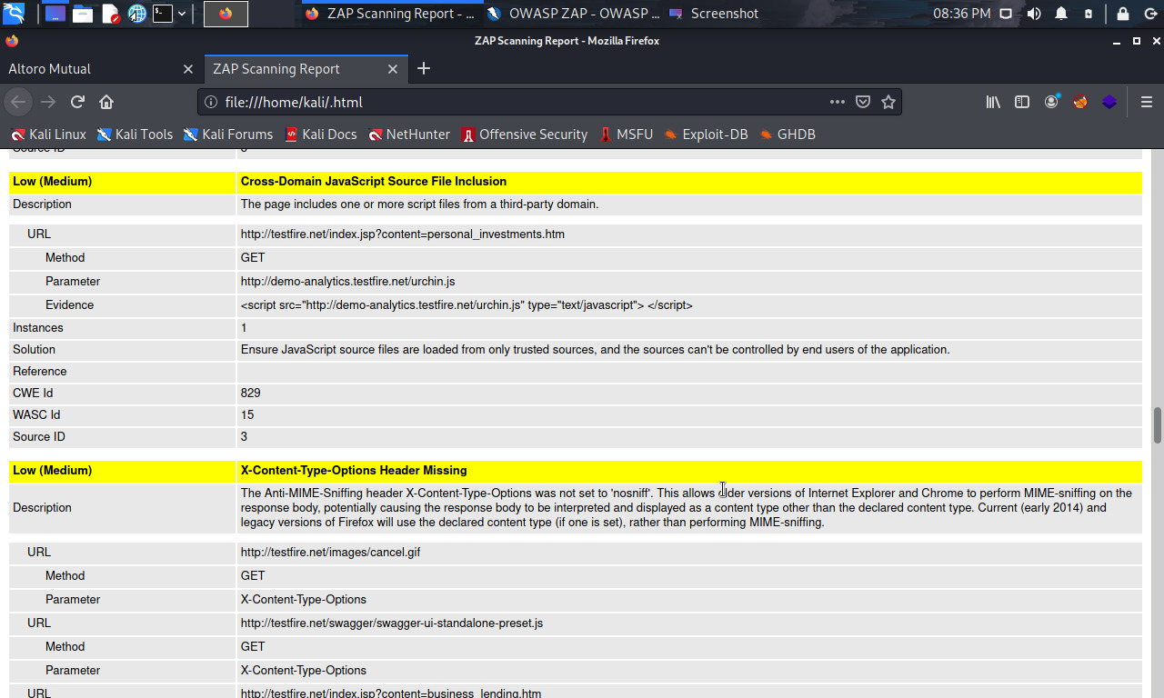

Slide 6
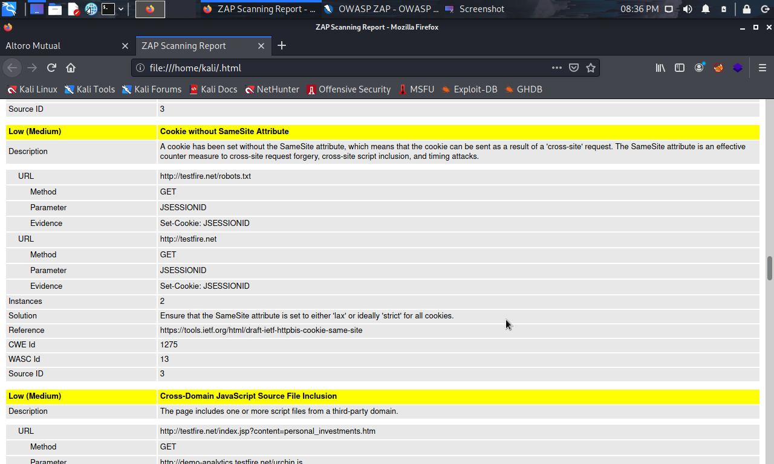

Slide 7
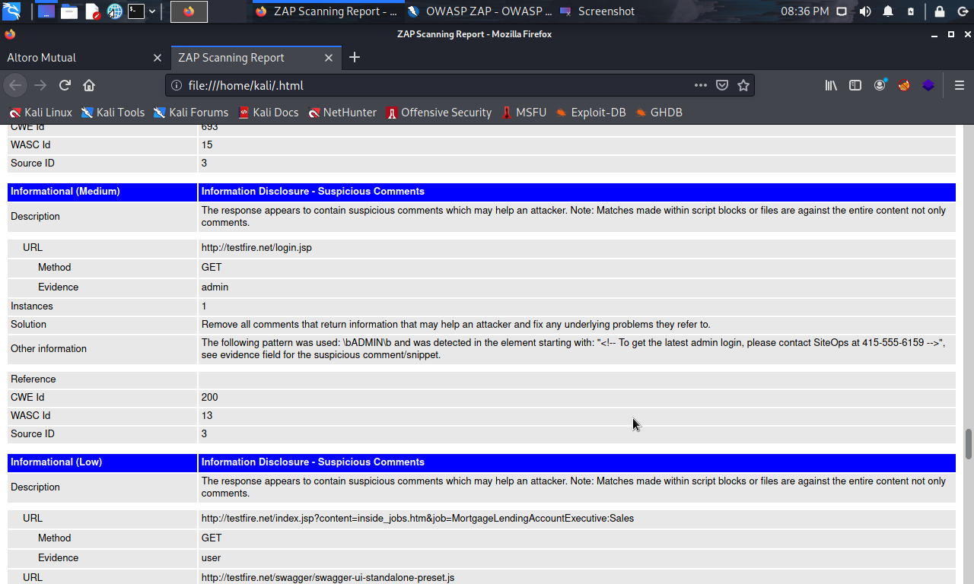

Slide 8
In report we can see, they are divided into four parts : Low :Vulnerability with low risks Medium :Vulnerabilities wil medium risk Critical :Vulnerabilities with high risks ,easy for black hat hacker to hack. Informational : Vulnerabilities which leak the critical information of the website

